Slide 1
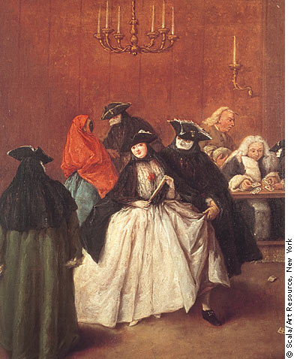
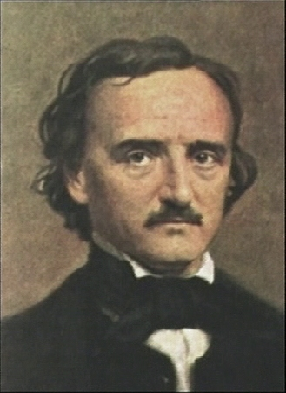
The Masque of the Red Death
Edgar Allan Poe

Slide 2
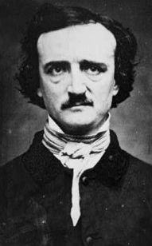
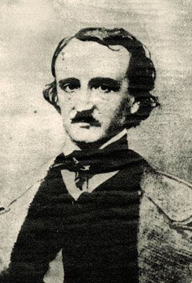
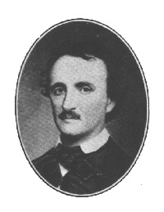
Edgar Allan Poe
1809-1849

Slide 3
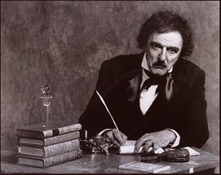
His Family and Tragic Life
Born in Boston
The son of traveling actors
Lived a tragic and unhappy life

Slide 4
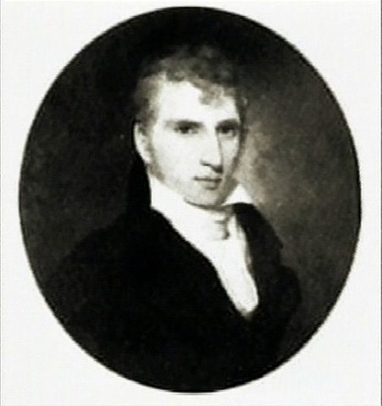
Tragic and Unhappy Life
Mother died of tuberculosis when Poe was one
Father deserted him at the age of two
Adopted by Mr. and Mrs. John Allan
Had constant disagreements with his step-father
John Allan

Slide 5
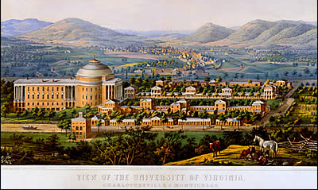
. . . continued
Studied briefly at the University of Virginia
Drinking and gambling difficulties kept him from continuing at UVA
University of Virginia, 1856

Slide 6
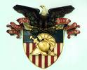
. . .continued
Received an appointment to West Point, but provoked his own dismissal
Caused a final separation between himself and step-father
West Point Crest

Slide 7
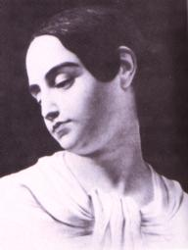
. . .continued
In 1836 married his 14 year old cousin, Virginia
Last 12 years of life worked as journalist, editor, and creative writer
Virginia Clemm

Slide 8
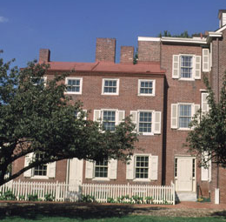
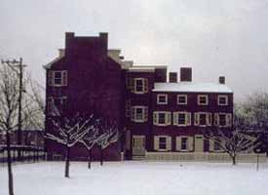
. . . continued
Lived in poverty stricken conditions most of his life
In 1846 wife died after a long illness
Poe’s home during the 1840’s

Slide 9

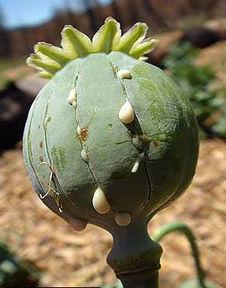
Addiction
All evidence suggests that Poe was an alcoholic.
Poe also habitually used drugs such as morphine, opium, and laudanum to treat depression and other health conditions.
  Poe had a weakened nervous system due to a brain lesion and a heart condition.
  Laudanum, a highly addictive, opium based medicine, was commonly used to treat headaches and stomach pains in 1800’s.

Slide 10
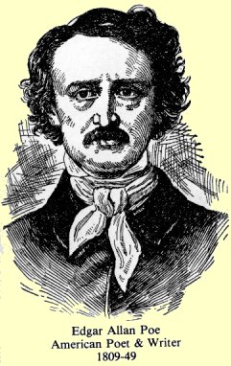
. . . continued
Died in Baltimore after having been found in a drunken stupor
Died a poor man

Slide 11
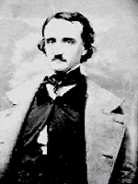
Poe’s Work
Known for:
  Tales of mystery and terror stories
  Introducing the modern detective story

Slide 12
Just a Few Titles
Short Stories:
  The Tell-Tale Heart
  The Cask of Amontillado
  The Black Cat,
  The Pit and The Pendulum
Poems:
  The Raven
  Annabel Lee
  To Helen
  Lenore

Slide 13

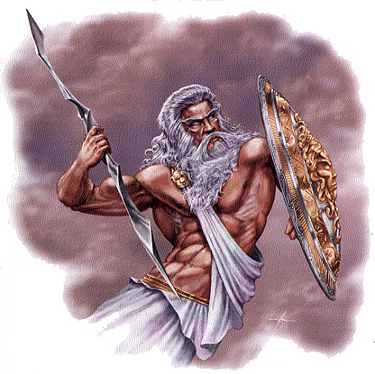
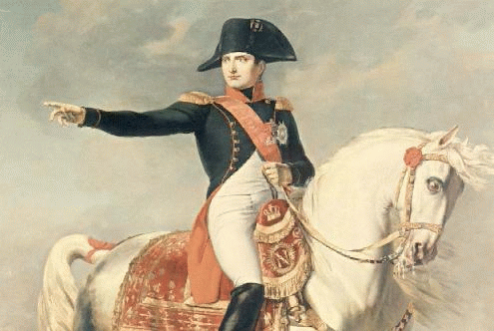
Literary Term: Allusion
Reference to a famous historical or literary figure or event
Best sources are literature, history, Greek mythology, and the Bible
Serves to explain or clarify or enhance whatever subject

Slide 14

Literary Term: Gothic Elements
Supernatural horrors and an atmosphere of unknown terror pervades the action
High emotion, sentimentalism, but also pronounced anger, surprise, and especially terror
Use of words indicating fear, mystery: apparition, devil, ghost, haunted, terror, fright, fainting

Slide 15
Literary Term: Symbol
Something that is itself and yet also represents something else
Universal symbols embodying universally recognizable meanings
Invested symbols give symbolic meaning by the way an author uses them in a literary work
Symbols are very common in literature

Slide 16
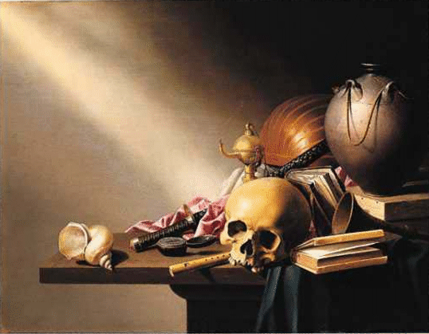
Allegory: A Story Behind a Story
An allegory is a narrative that is really a double story. One story takes place on the surface. Under the surface the story’s characters and events represent abstract ideas or states of being, things like love or freedom, evil or goodness, hell or heaven.
To work, an allegory must operate on two levels. On the level of pure storytelling, an allegory must hold our attention. Its characters must seem believable and interesting enough for us to care about them. On the allegorical level the ideas in the story must be accessible to us. As you read, you should find that the allegorical level of the story gradually begins to strike you.
See if you find that Poe’s story of arrogance and death hooks you on both levels.

Slide 17
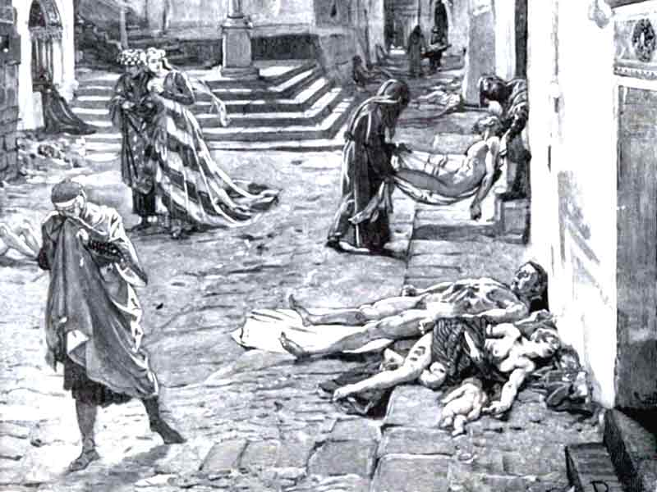
The Masque of the Red Death:
Background
Poe’s fictional Red Death is probably based on the Black Death, which swept fourteenth-century Europe and Asia, killing as many as two thirds of the population in some regions in less than twenty years. Poe calls the plague “the Red Death” because victims oozed blood from painful sores. In this story a fourteenth-century prince gives a costume party, or masque, to try to forget about the epidemic raging all around him.

Slide 18
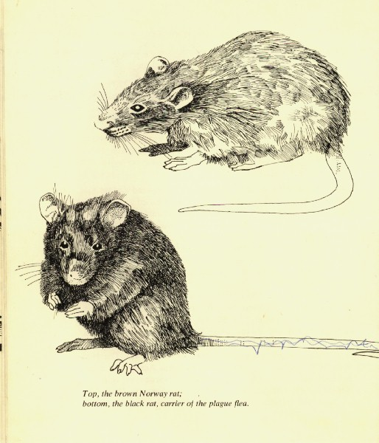
The Black Death
This particular type of plague was the bubonic plague, which is caused by a bacteria that lived in rats and other rodents. Human beings were infected through bites from the fleas that lived on these rats. The symptoms associated with plague are bubos, which are painful swellings of the lymph nodes. These typically appear in the armpits, legs, neck, or groin. If left untreated, plague victims die within two to four days. Victims of this disease suffered swelling in the armpit and groin, as well as bleeding in the lungs. Victims also suffered a very high fever, delirium, and prostration.

Slide 19
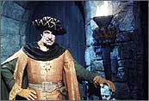

Summary
Poe’s tale of an eccentric nobleman and the Red Death ravaging his land can be read both as a chilling ghost story and as an allegory representing human folly and the inevitability of death. (In other words, you cannot hide from death regardless how much money you have.)

Slide 20
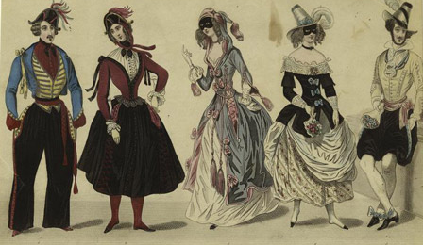
Summary
Prince Prospero invites a thousand lords and ladies to escape death by living luxuriously in his castle until the pestilence passes.
To entertain his guests Prospero hosts a masquerade party that takes place in seven halls, each a different color.

Slide 21
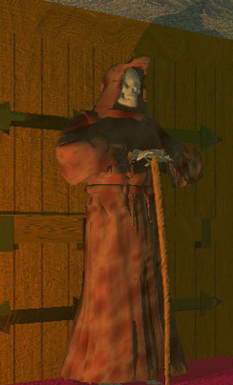
Summary
At the stroke of midnight, a tall figure in a blood-splattered burial costume appears.
Prospero demands that his friends seize the intruder, but everyone is frozen with fear as the stranger slowly walks through the rooms.
Finally, Prospero rushes after him into the black seventh room.

Slide 22
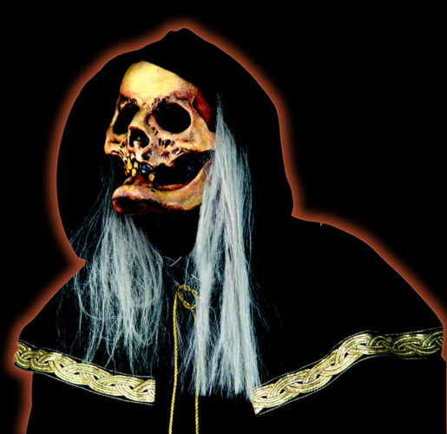
Summary
When the intruder turns, the host falls dead.
The revelers then grab the stranger but find the costume empty.
All soon die of the Red Death.

Slide 23
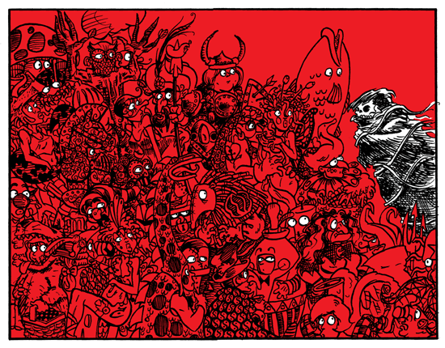
Comments
The allegorical meaning of the story is found in such details as
  Prospero’s name (Prospero means prosperous)
    Unfortunately, the Red Death attacks the rich and poor alike
  The stranger’s appearance (Dressed like the Grim Reaper or Death)
  The arrangement of the seven halls
    The rooms of the palace, lined up in a series, allegorically represent the stages of life.
  Their colors, particularly the black (death) and red (blood) of the westernmost room with its ebony clock marking the inevitable passage of time.
“No matter how beautiful the castle, how luxuriant the clothing, or how rich the food, no mortal, not even a prince, can escape death. “
-Sparknotes.com

Slide 24
This powerpoint was kindly donated to www.worldofteaching.com
http://www.worldofteaching.com is home to over a thousand powerpoints submitted by teachers. This is a completely free site and requires no registration. Please visit and I hope it will help in your teaching.

